Slide 1
And-Inverter Graph Rewriting
Lakhan Shiva Kamireddy

Slide 2
Introduction
Representation of Boolean formulae is important in Formal Verification
We have already seen Binary Decision Diagrams. BDDs are canonical representations.
A non-canonical representation is and-inverter graph (AIG).
With the loss of canonicity, they are highly scalable, efficient.
Two-input and functions at vertices and inverter attributes on edges.
They were a topic of interest since 1950s.

Slide 3
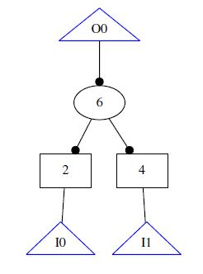
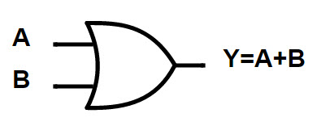
Conversion to AIGs
Conversion of an OR gate to and-inverter graph. We use DeMorgan’s laws to get to this form.

Slide 4
AIG Rewriting
AIG Rewriting is an optimization technique that is alternated to reduce area by sharing common logic.
My work is centered around implementing DAG-Aware Rewriting algorithm proposed by Berkeley Logic Synthesis and Verification group.
Rewriting is a fast greedy algorithm for minimizing AIG size by iteratively selecting AIG subgraphs rooted at node and replacing them with smaller pre-computed subgraphs.
Let us see some concepts important to this algorithm.

Slide 5
Boolean Networks
Cut, k-feasible cut computation, NPN equivalence

Slide 6
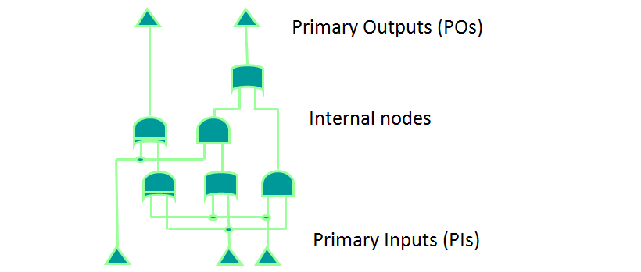
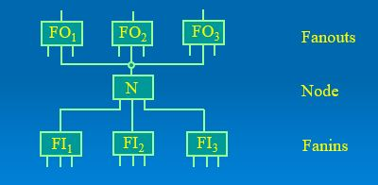
Cut
Each node has only one output.
A node can have any number of inputs(fanins) and can be input to any number of nodes (fanouts)
Transitive fanin or fanout means, there is either a direct or indirect connection between the gates.

Slide 7
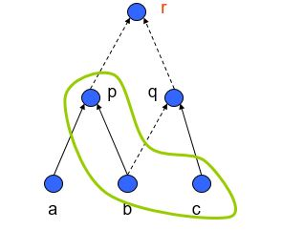
Cut
A cut of a node n is a set of nodes(leaves) in transitive fan-in such that every path from the node to the PI is blocked by at least one leaf in the cut.
A k-feasible cut means the size of the cut must be k or less. Above is a 3-feasible cut.

Slide 8
NPN equivalence
Two Boolean functions, F and G belong to same NPN-class if F can be derived from G by negating (N) and permuting (P) inputs and negating (N) the output.
For example, F=ab + c and G=ac + b are NPN-equivalent because swapping b and c make them identical.
If there are n variables there are 2^{n} combinations. Each of these combinations can be true or false, i.e. for n variables there are 2^{2n} boolean functions.
Let us say we have 2 variables, A and B.

Slide 9
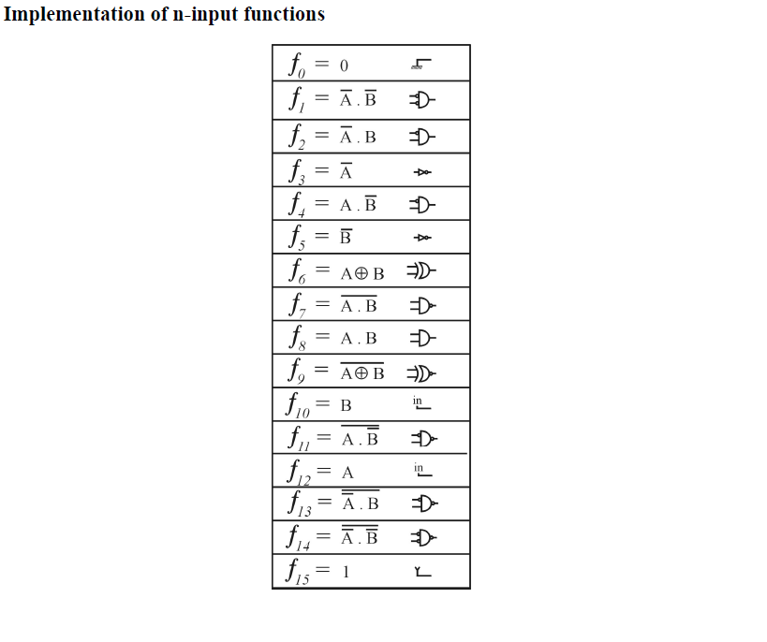
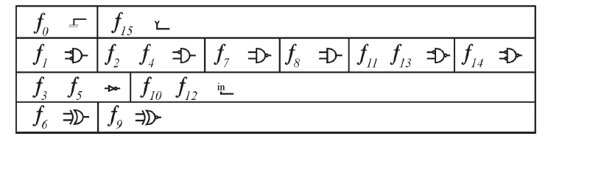
NPN equivalence

Slide 10
NPN equivalence
NPN equivalent functions can be implemented with the same circuit plus some inverters.
This way it is possible to use a smaller library composed of one representative gate for each NPN class plus one inverter cell.
For 4-input functions there are 222 NPN equivalence classes.
Out of these only about a 100 appear more than once as functions of 4-feasible cuts in benchmarks.
Only about 40 of them have been found experimentally to lead to improvements in rewriting.

Slide 11
Algorithm
For 4-input AIG rewriting, all 4-feasible cuts of the nodes are enumerated.
For each cut, the Boolean function is computed and its NPN-class is determined by a hash-table lookup of pre-computed structures.
For each structure in the possible structures, identify the structure that gives maximum gain in terms of number of nodes.
Keep updating the best structure until the gain is maximized among the possible structures.
Replace the subgraph with the maximum gain pre-computed structure.
Output the best gain in the overall graph.

Slide 12
Implementation
Implemented it in C language.
Used AIGER library to store and manipulate And-inverter graphs.
Wasn’t able to perform a hash table based implementation.
Was able to rewrite AIGs structurally.

Slide 13
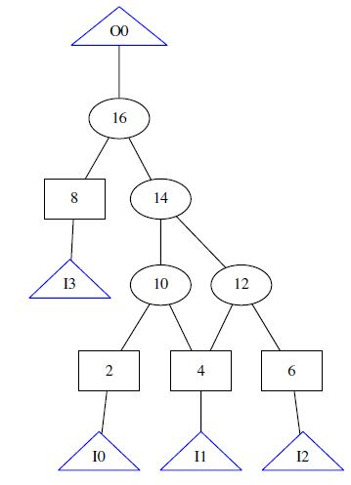
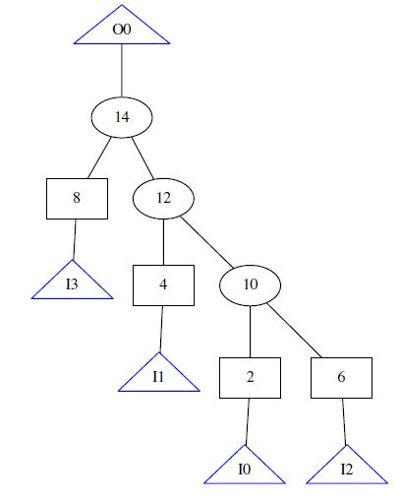
Results

Slide 14
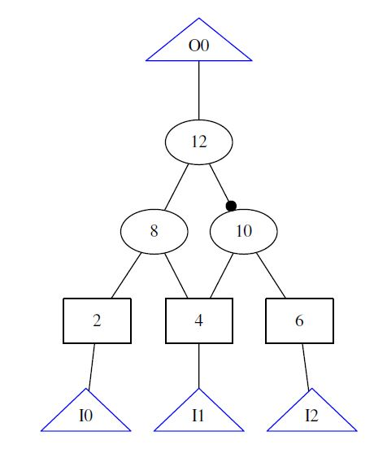
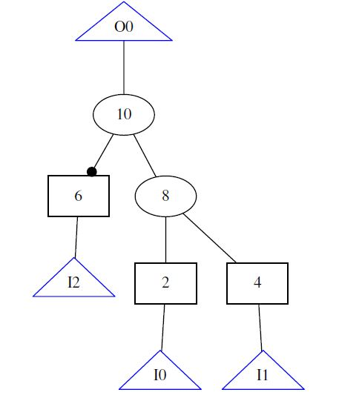
Results

Slide 15
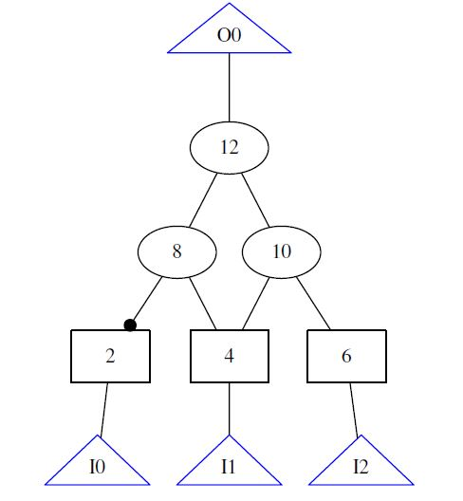
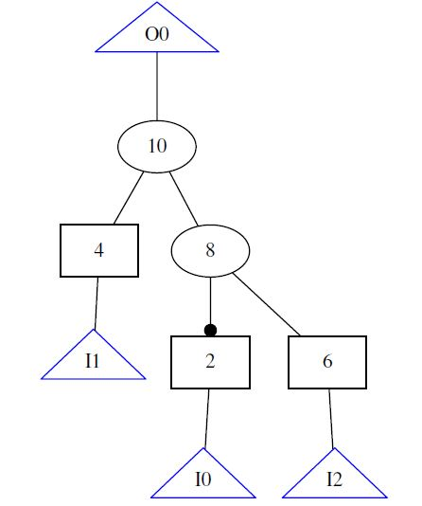
Results

Slide 16
Results
S.no | And gates before rewriting | After rewriting
1. | 4 | 3
2. | 3 | 2
3. | 3 | 2

Slide 17
Conclusion
What have I learnt? What can be improved?

Slide 18
What have I learnt?
Different logic representations – AIGs
Cuts and NPN equivalent classes
Using AIGER library
Coding structural rewriting (supporting AIGER format)

Slide 19
Ways To Improve
The results did not show any improvement on the AIGER benchmark files.
The reason may be because the 40 NPN equivalent classes that practically appear in the benchmarks have not been structurally rewritten.
A hash-table look up implementation may improve the results.

Slide 20
References
[1] Alan Mishchenko, Satrajit Chatterjee, and Robert Brayton. Dag-aware aig rewriting a fresh look at combinational logic synthesis. In Proceedings of the 43rd annual Design Automation Conference, pages 532535. ACM, 2006.
[2] Andreas Kuehlmann and Florian Krohm. Equivalence checking using cuts and heaps. In Proceedings of the 34th Annual Design Automation Conference, DAC '97, pages 263268, New York, NY, USA, 1997. ACM.
[3] Johannes Keppler University Formal Verication Group. Benchmarks. Technical report, http://fmv.jku.at/aiger/, 2004.
[4] P. Bjesse and A. Boralv. Dag-aware circuit compression for formal verication. In Computer Aided Design, 2004. ICCAD-2004. IEEE/ACM International Conference on, pages 4249, Nov 2004.

